Slide 1


















An IOT based framework for Statistical Analysis and Screening of Covid-19
PRIYANKA WALEKAR 19204008
APOORVA GADKARI 18104043
PRATIK GHOLAP 18104070
PROJECT GUIDE
Dr. Uttam Kolekar
Co-Guide
Prof. Sonal Jain

Slide 2
Contents
Abstract
Introduction
I. Problem Identified
II. Solutions Proposed
Objective
Scope
Functionality
Technology Stack
State Diagram/Workflow
Conclusion
References

Slide 3

1. Abstract
One of the most Terrifying outbreaks in recent times has been the outbreak of COVID-
19. The extent of this disease can be understood by the fatality rate of this disease." precaution is better than cure" is a quote that everyone has heard at least once in their lifetime and is prevalent in the case of preventing the spread of coronavirus. There must be a question in mind how we can take extra precautions from Covid? Simple answer is following the rules given by government and continuously monitoring the factors which indicates the symptoms. This project is basically of designing an İOT framework which will be having a temperature sensor LM35 for check body temperature, pulse sensor to detect pulse rate and a SpO2 for oxygen rate detection.
A low-power wireless respiratory monitoring system with cough detection is proposed to detect various parameters that are required for the overall detection of this disease. Further, this data via an Arduino will be processed on cloud where Support Vector Machine algorithm will be performed and send the diseases prediction on the application as a conclusion. The proposed system will always used when person comes outside from house as a precaution and it can be used for actual patient monitoring and thus can be used for effective analysis and detection of this disease.

Slide 4

2. Introduction
Problems Identified:
Testing results take time
Some tests are not that accurate
It is not possible that everyone has taken the vaccine
Proposed Solution:
The aim is to develop an screening of patients with various sensors like LM35 and pulse rate sensor to make a statistical data of that patient and predict whether he/she has covid-19 or not that is faster and more accurate than RT-PCR test

Slide 5

3. Objectives
To measure Oxygen Rate, Pulse Rate & Body Temperature using Framework.
Collect the measured data and performing SVM Algorithm on Cloud to predict the diseases.
Display the predicted output on the Android Application.

Slide 6

4. Scope
Can help the government for analysis of covid-19 data
Can be used at any shop or even before entering a house

Slide 7
5. FUNCTIONALITY.
Monitoring pulse rate-measures the heart rate to get a basic idea about the blood circulation.
Oxygen level- it shows how much oxygen is carried by person’s RBC’s.
Spo2-measures the amount of O2 carrying hemoglobin in the blood.

Slide 8
6. TECHNOLOGY STACK
Arduino Uno and Programming Cable
ESP8266 Wi-Fi module
LM35 temperature sensor
Pulse rate sensor
Push button10k Resistor
Male-female wires
Breadboard
Google firebase
Ubidots/IBM Cloud Service 10.Android Studio
11.Android IDE

Slide 9
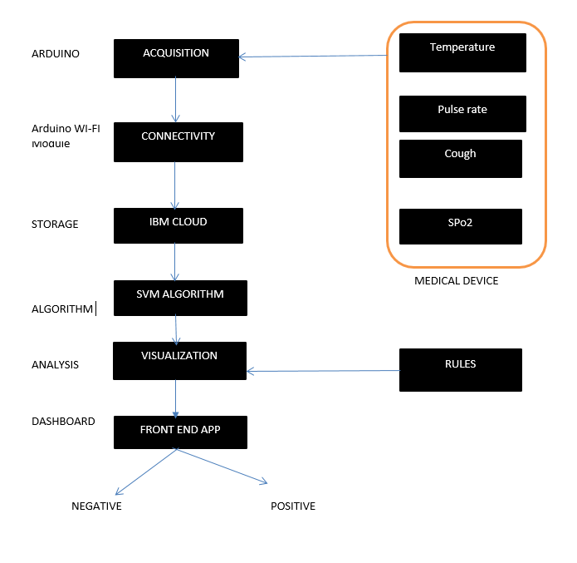
7. State Diagram/Workflow

Slide 10

8. Conclusion
The COVID-19 virus has been around for almost a year now and the medical community, scientists, and researchers are trying their best to identify a cure for the disease. At the same time, people around the world are facing issues in determining the state of an individual as healthy or affected by the virus.
Considering the numerous difficulties and the associated dangers in its diagnosis, it is
preferable to be able to perform the disease detection using wearable devices.
We proposed a framework for remote screening of the virus using standards based practice identified in the literature. The framework utilizes sensors combined in the form of a wearable device that can be worn by any individual to know in a few
seconds whether the person is healthy or is doubtful of carrying the disease.
The framework requires testing on a large population and at the same time the data obtained through testing can be used for advanced analytics such as outbreak prediction and prevention, population segmenting, as well as helping the government
and decisionmakers to take appropriate measures.

Slide 11

9. Suggestion
Focus on Software Implementation
Preparation of Paper ready for Publishing

Slide 12

9. References
Johnson, R.M.; Vinetz, J.M. Dexamethasone in the management of
covid-19. BMJ 2020.
An IoT framework for Screening of Covid-19 using Real-Time Data
from Wearable Sensors.
CDC (Centers for Diseases Control and Prevention). About Variants of the Virus That Causes COVID-19. Available online: https://www.cdc.gov/coronavirus/2019-ncov/transmission/variant.html (accessed on 3 April 2021).

Slide 13
Thank You...!!

